Slide 1

Inter-city Car Pooling System
Submitted By:
Mahesh Bhabad (230343020055)
Tarun Rathore (230343020099)
Nikhil Madhekar (230343020052)
Mohsin Naqvi (230343020079)
Guided By:
Mrs: Bakul Joshi

Slide 2
Contents
Introduction​
Architecture
​Database Design
Technology platform used for project
User roles and responsibilities
Division of work within team
Details of contribution of each team members
File and directory structure for project
Read me file
Future extension if any
Conclusion

Slide 3
Introduction
The online carpooling system is a platform designed
to connect individuals who are traveling in the
same direction so they can share a ride together.
It aims to provide a more sustainable and cost-effective
transportation option by reducing the number of vehicles
on the road and optimizing the use of existing resources.
Notes:
Hive and Hive QL statements have been used for querying the data.
For future scope, various different Machine Learning algo0rithm will be implemented on different flight delay datasets.

Slide 4
Project Architecture
Used for
User interfacing
Basic data validation
Used for
Permanent data storage
Database level validation
Database access using stored procedures
Used for
Server side validation
Response handling
Business Logic
Database operations
Front end Layer
Server Layer
Technologies used
HTML, CSS
Javascript
ReactJS
JSON
Database Layer
Technologies used
Springboot
Hibernate
Technologies used
MYSQL

Slide 5
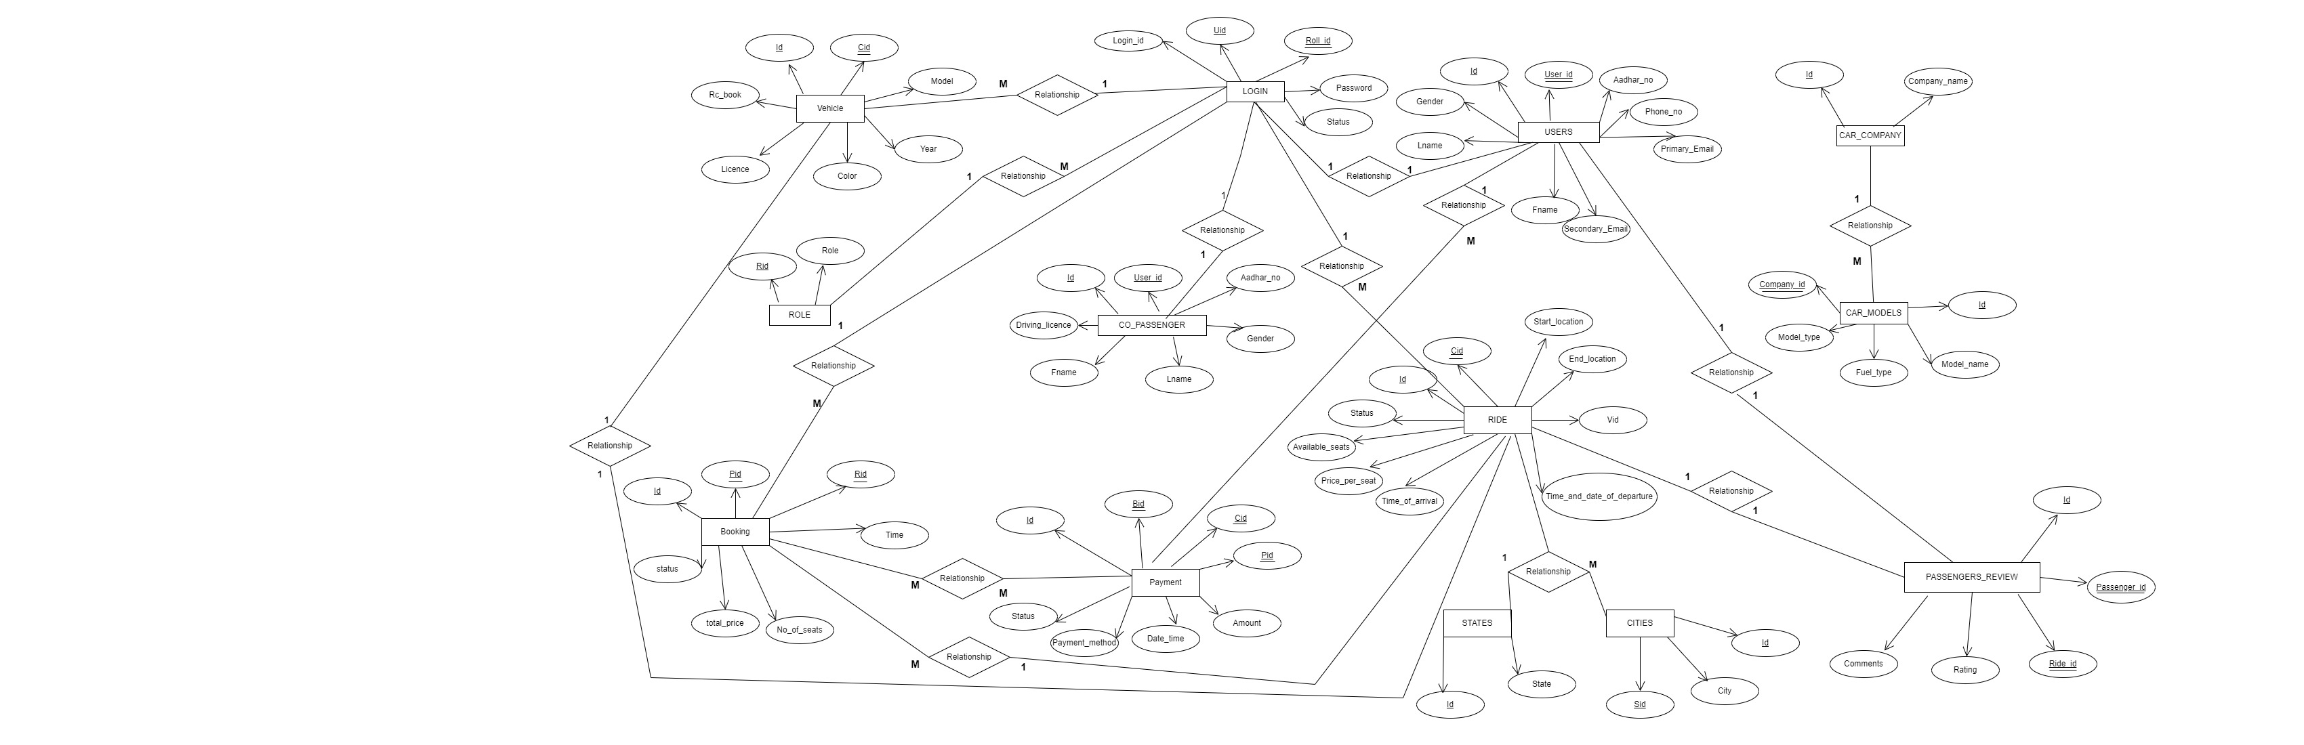
ER Diagram

Slide 6
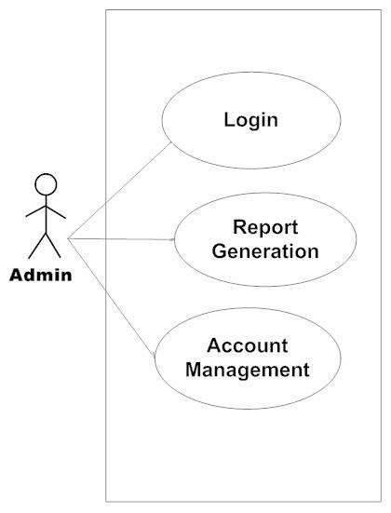
Use Case Diagram
1. Admin

Slide 7
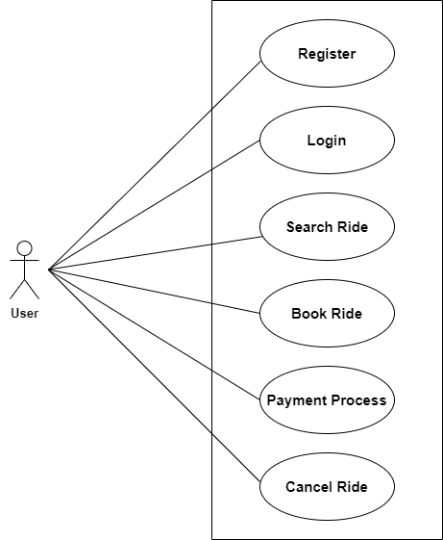
2. User

Slide 8
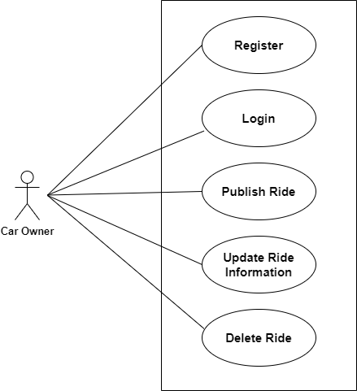
3. Car Owner

Slide 9
Technology platform used
Technologies used :
HTML, CSS, Javascript, ReactJS, JSON, Springboot, DotNet MVC Core, Hibernate, MySQL
Reason :
HTML, CSS and javascript are used for frontend part for static web pages.
React JS is used for rendering the dynamic web pages and to create a single page application where only particular part of web page is rendered without altering complete web page.
Springboot is used for server side processing where in connection with database is established from server and required data is manipulated and sent to client side.

Slide 10
Roles and responsibitities
Roles
Car Owner
Car User
Admin
Responsibilities of each user
Car Owner - Car Owner get benefited from our application as he/she get financial benefit as well as companionship along the journey.
Car User -Car User get benifited from application as Car User get optimized cost of travel, faster travelling, and avoiding public transport.
Admin-Account management, permission to allow users and car-owner passenger.
User cases of each user
Car Owner - update profile, create ride , cancel ride, update ride.
Car User - update profile, book ride , cancel ride, pay ride.
Admin - Account Management, Monitoring Application, and generating reports.

Slide 11
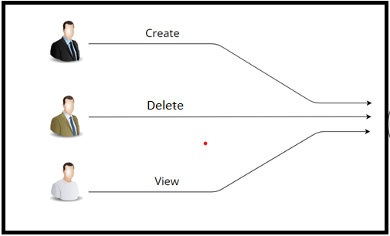
Working

Slide 12
Features
Admin can Allow all type of Users.
Admin can can disable all type of User’s account.
Admin can manage account details.
Car-Owner can create ride.
All Users can add details and register itself.
Car-Owner can create ride and cancel ride.
All Users can update their details.
Car-User can add review to ride .
Car-User can book the ride and pay for their booking.

Slide 13
Benefits
Private Vehicle Owners: Individuals who own a car and offer rides to other users through the carpooling system.
It is very easy to use.
The individuals who have cars seats available for share transportation with others.
It saves a lot of time and money .
Eco-friendly: Government and Regulatory Authorities: Reduce traffic congestion and promote sustainable transportation.
Travelers: People who use carpooling for long-distance trips.

Slide 14
Benefits
Passenger seek shared rides with drivers heading towards in the same city. It provides custom features development and support with the application.

Slide 15
Conclusion
Challenges we faced :
There were many challenges that we faced like finding a right path to start with, exploring the technologies beyond the horizon of our course etc.
Things Learnt :
We have learnt to efficiently distribute the task within the team. We have learnt to combine all the dynamic stack of technologies together to create a fully functional software.
Overall Experience :
Overall experience was very practical oriented and highly knowledgeablee faced :

Slide 16
Future Scope
Carpooling is the sharing of car journeys so that more than one person travels in a car, and prevents the need for others to have to drive to a location themselves with own car.
Reduce traffic congestion – The benefits of carpooling on a large scale are huge. The software is flexible enough to be modified and implemented as per future requirements. We have tried our best to present this free and user–friendly website to Society.

Slide 17
THANK YOU

